Slide 1



map()
forEach()
filter()
find()
reduce()
Class
Object
Inheritance
Prototypical inheritance

Slide 2


array.map()

Slide 3
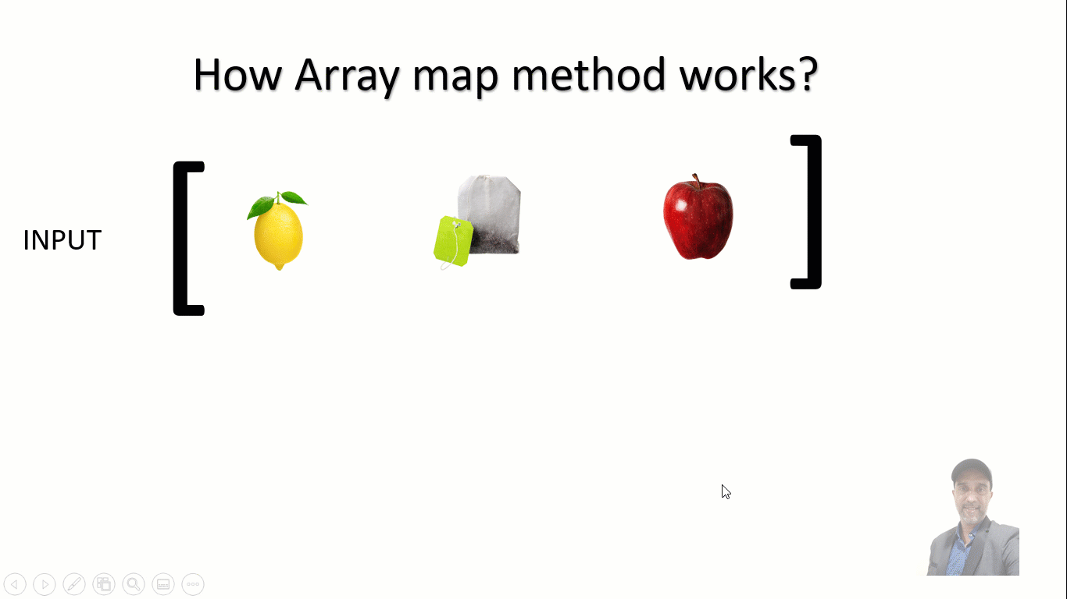
Ref: tyc-wordpress.s3.amazonaws.com

Slide 4
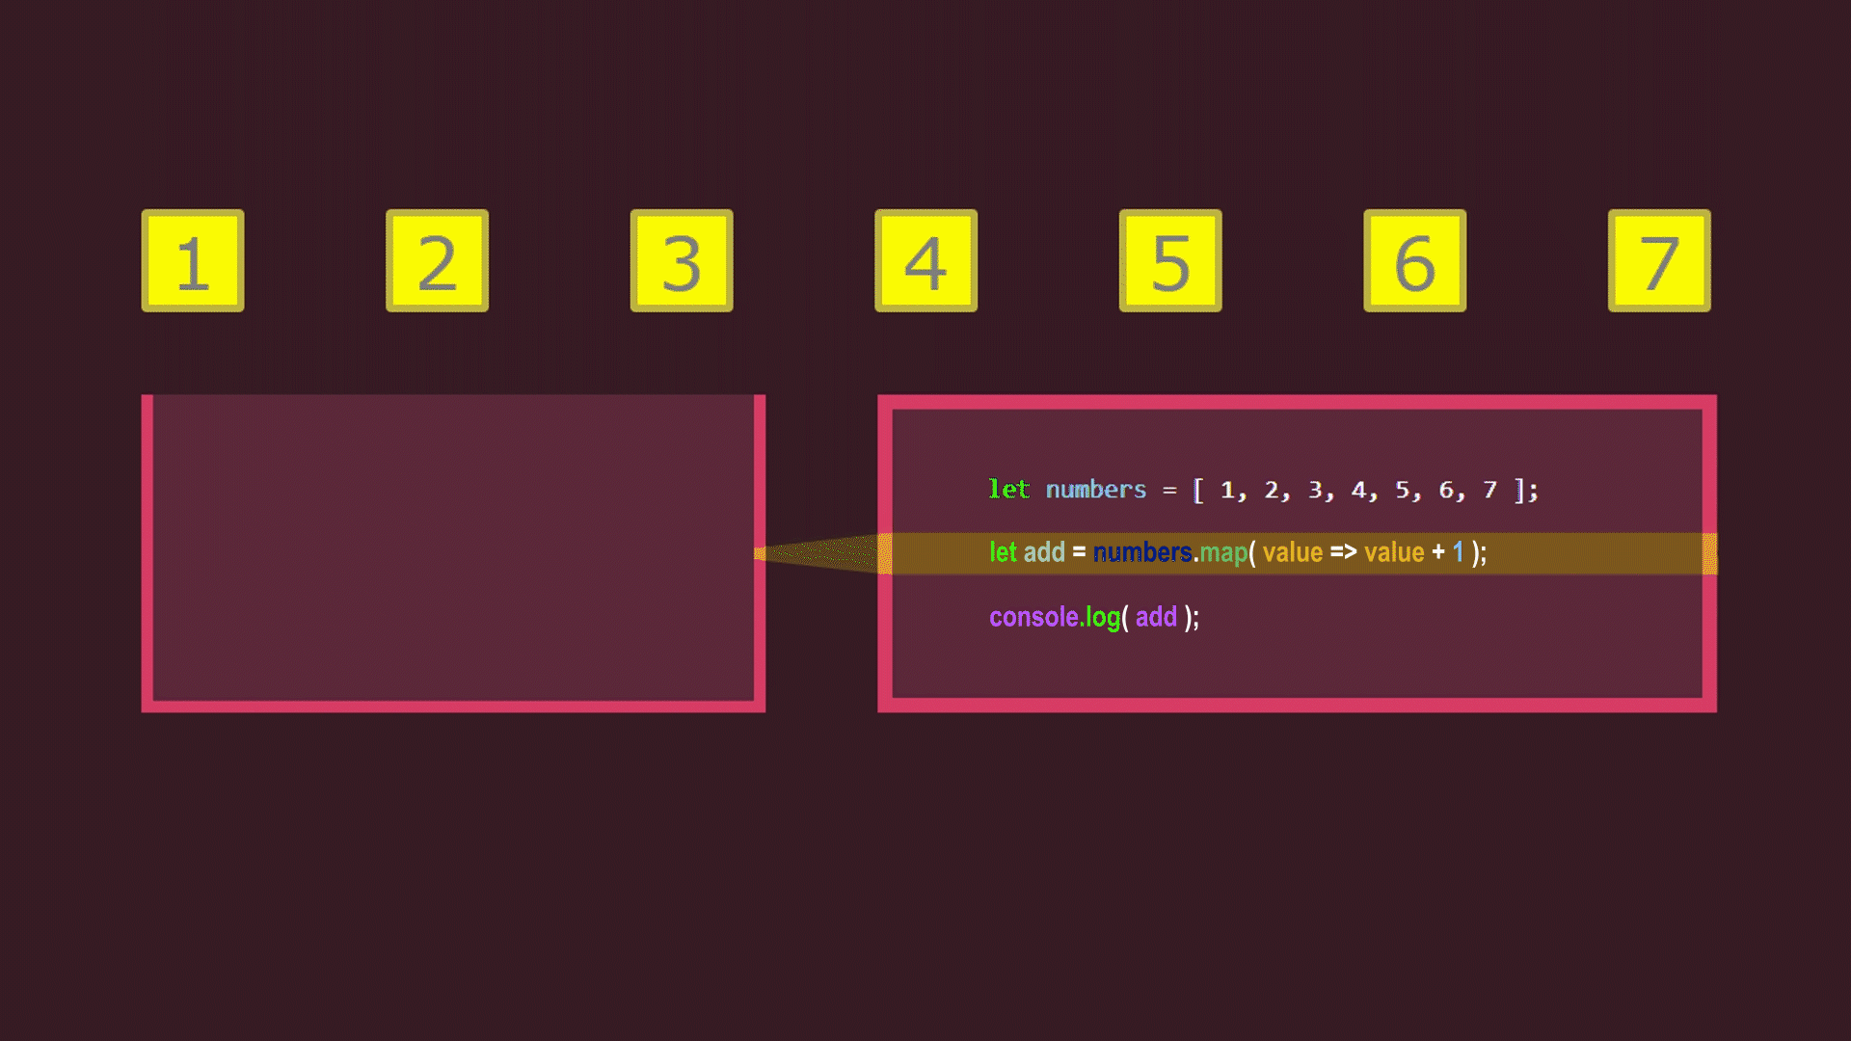
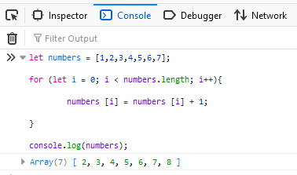
Array map to do one line loop magic
Array loop

Slide 5
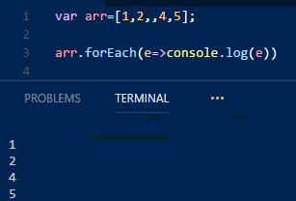

Slide 6
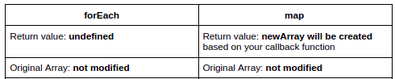

Slide 7
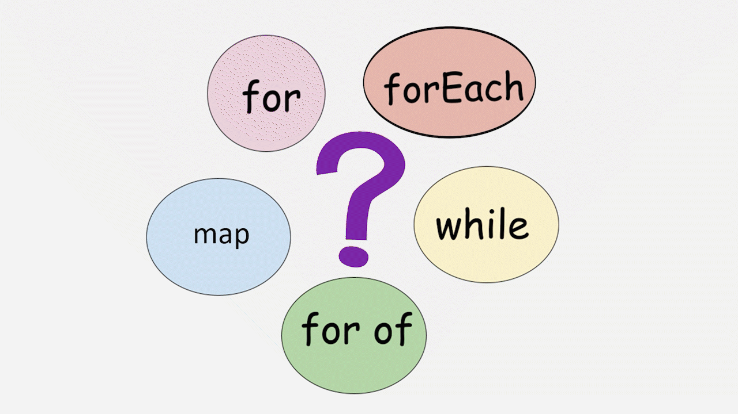

Slide 8

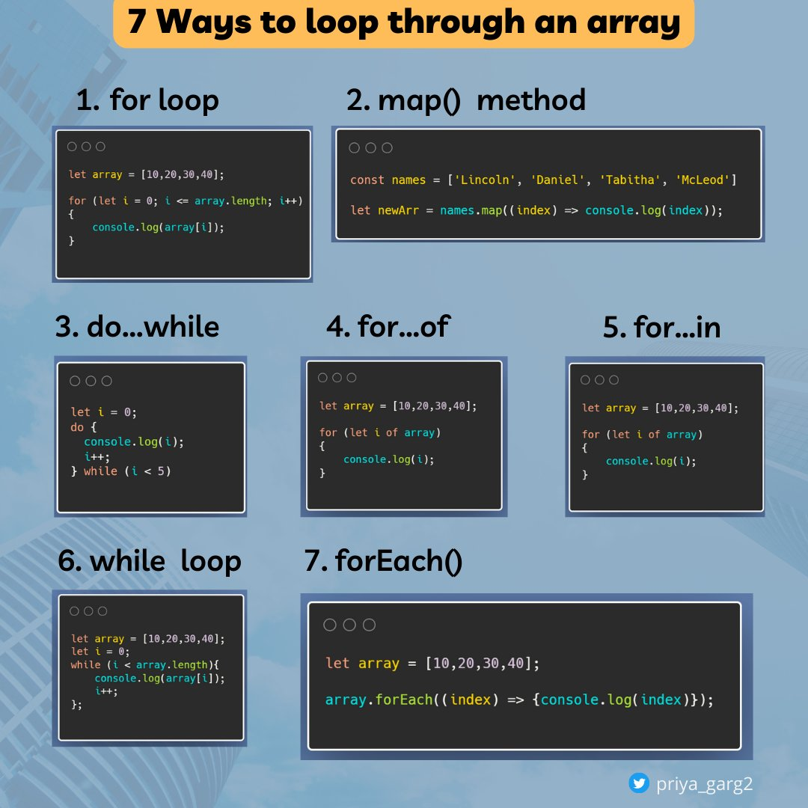

Slide 9

What is filtering?

Slide 10
array.filter()

Slide 11
array.filter()

Slide 12

What are you finding?

Slide 13

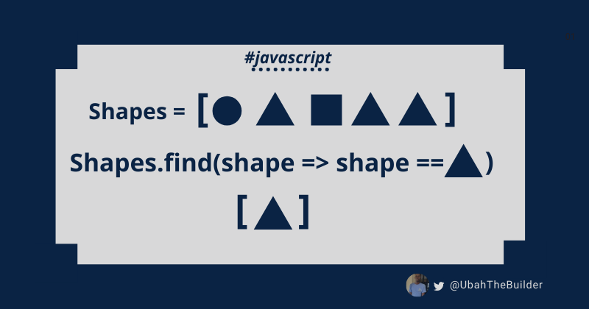
array.find()

Slide 14
array.find()

Slide 15
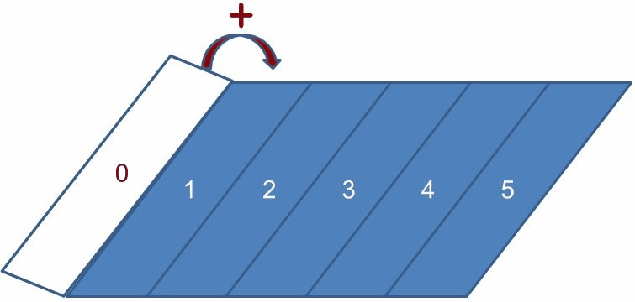
array.reduce()
Ref: freecodecamp

Slide 16
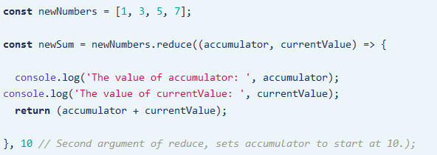
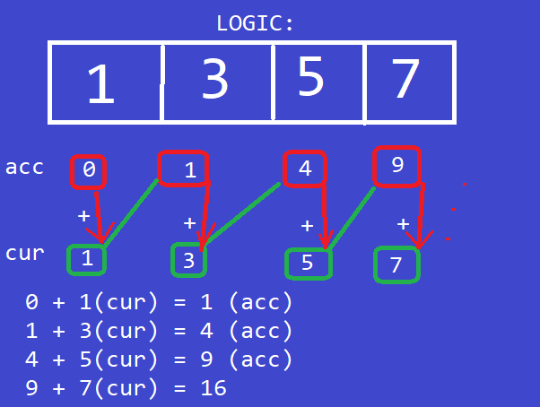
array.reduce()
0 );

Slide 17
array.reduce()

Slide 18
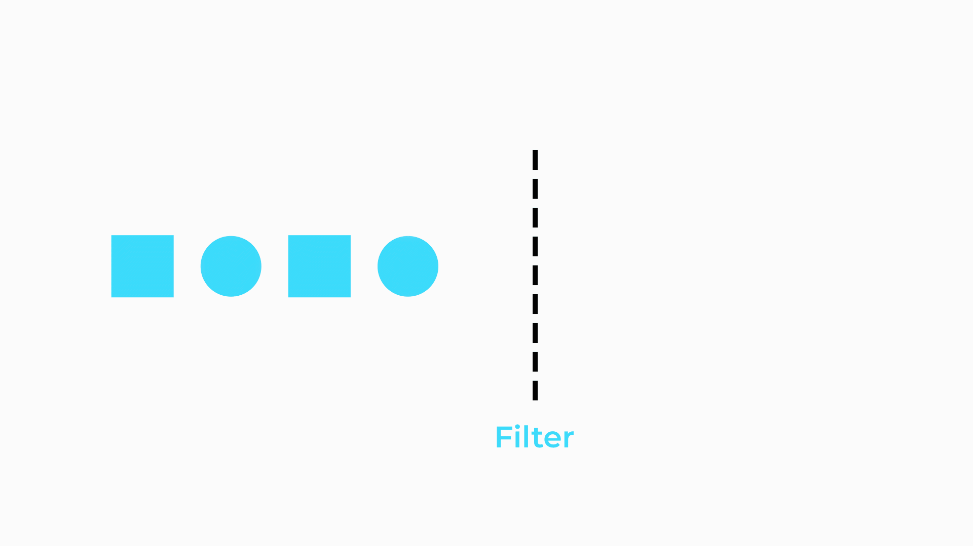
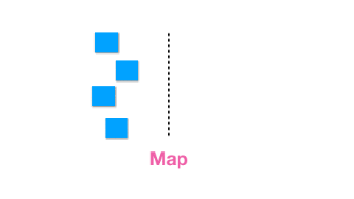
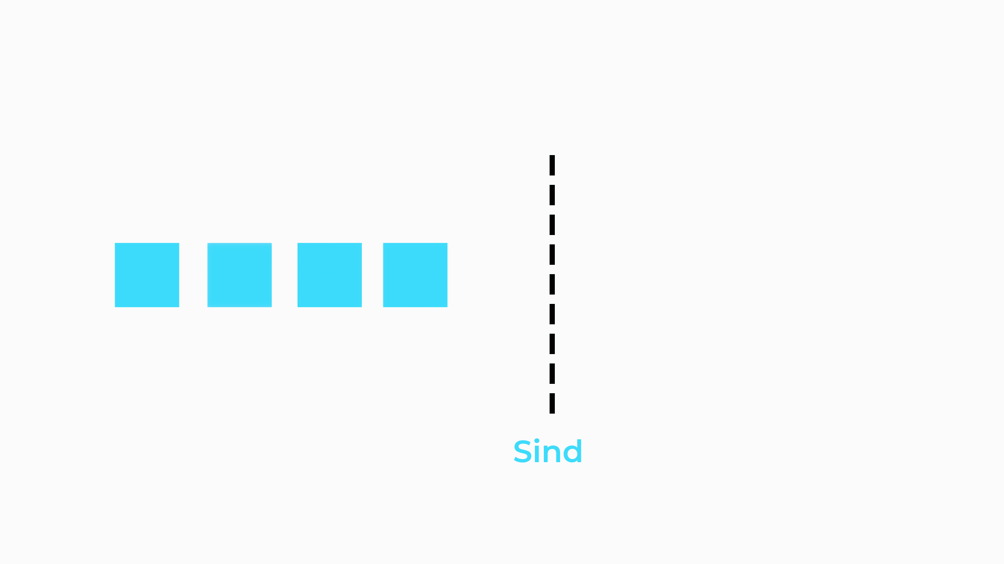
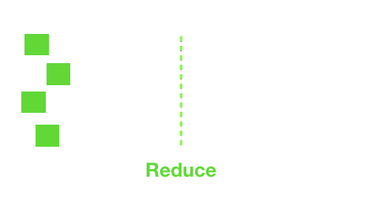
Find

Slide 19
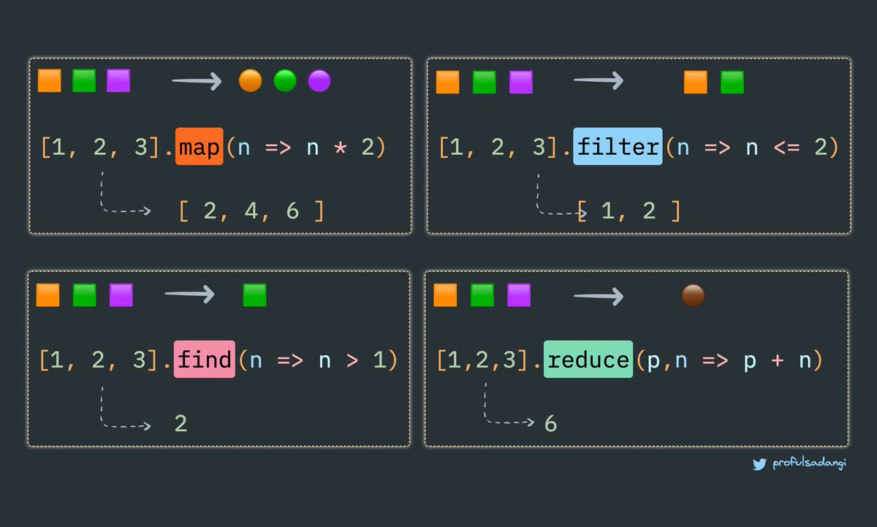

Slide 20
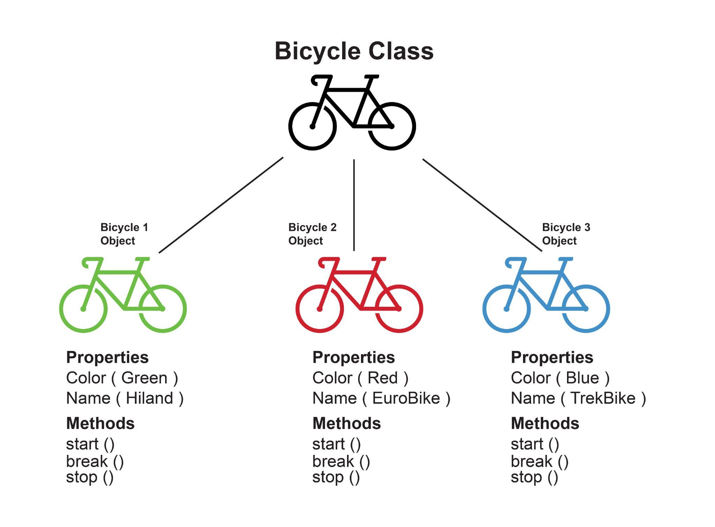

Slide 21
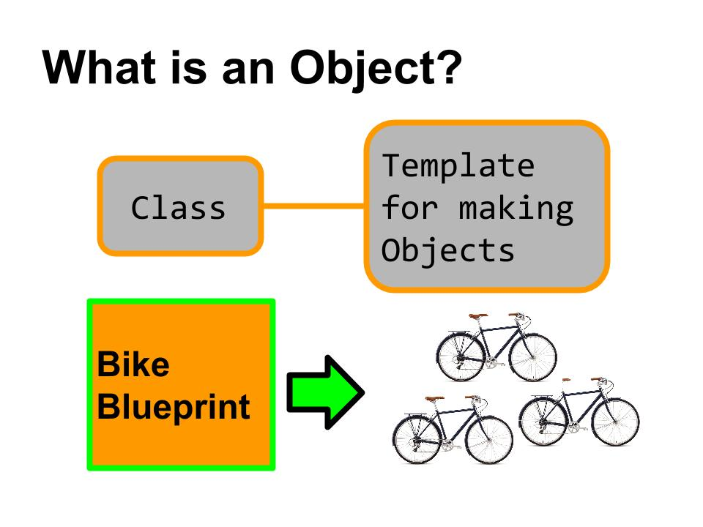

Slide 22
OBJECT
PROPERTY
METHOD
Attribute or state
Do something
function & procedure

Slide 23
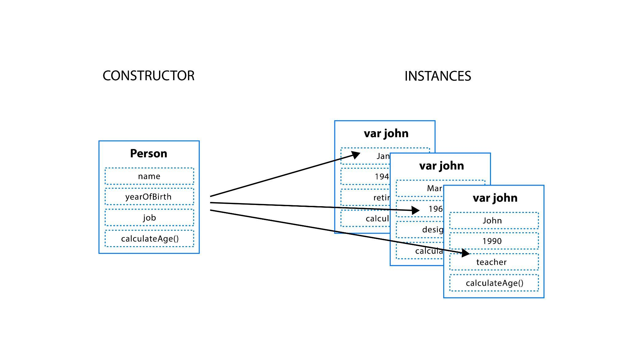
jane
mar

Slide 24
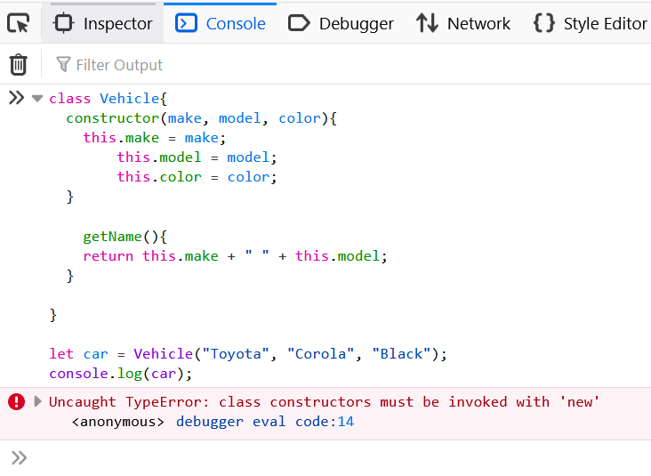
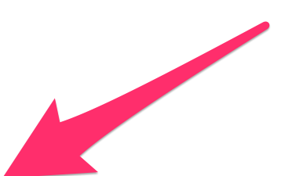
Creating object with constructor

Slide 25
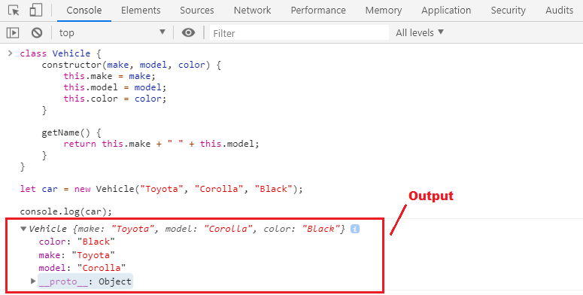
Creating object with constructor

Slide 26
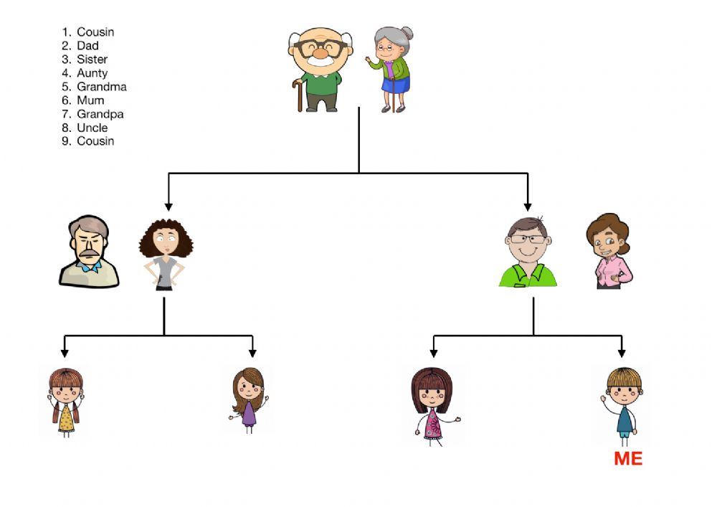
Family tree

Slide 27
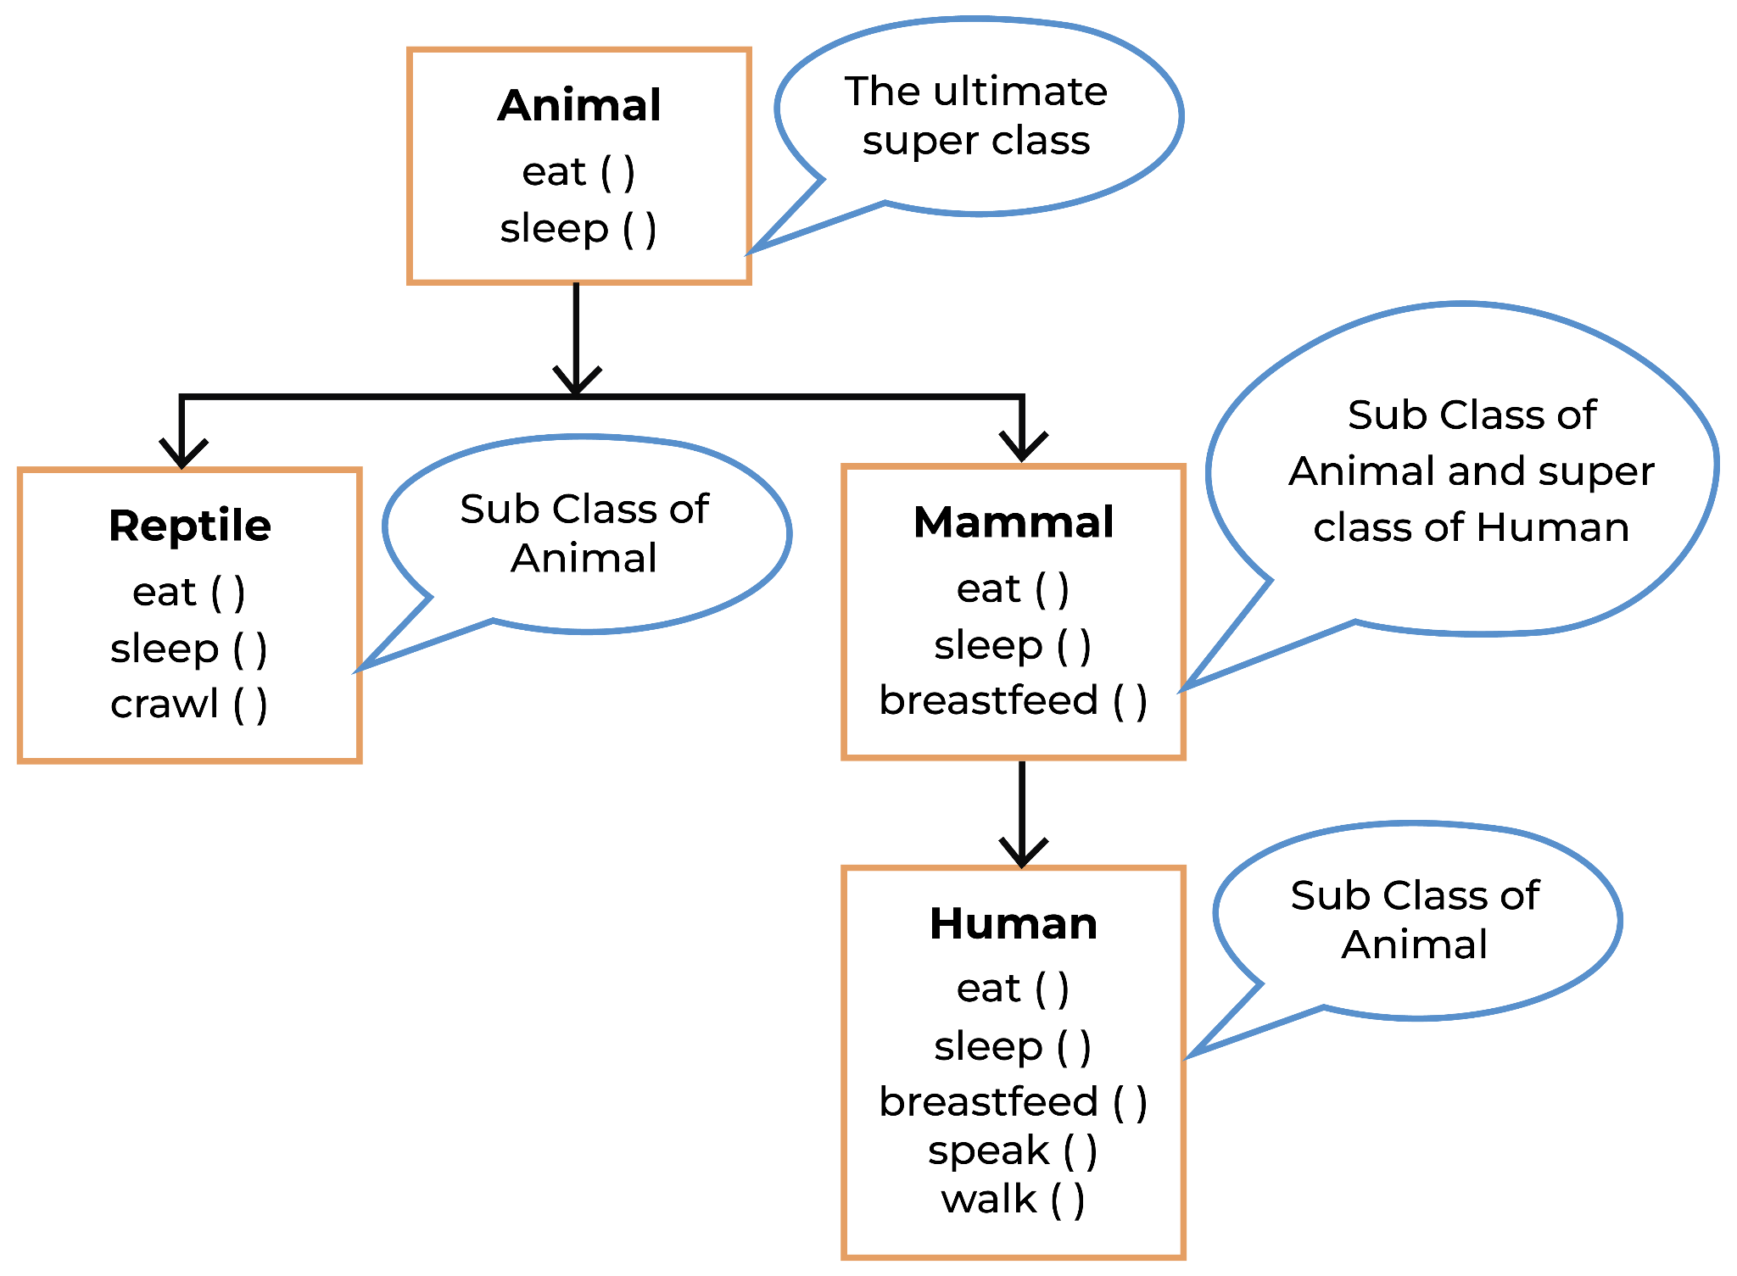
Super class VS Sub class

Slide 28
Prototypical inheritance refers to the ability to access object properties from another object. We use a JavaScript prototype to add new properties and methods to an existing object constructor.
Base-class
PROTOTYPE
instance
Sub-class
Sub-class
Sub-class
INSTANCE
INSTANCE
INSTANCE

Slide 29
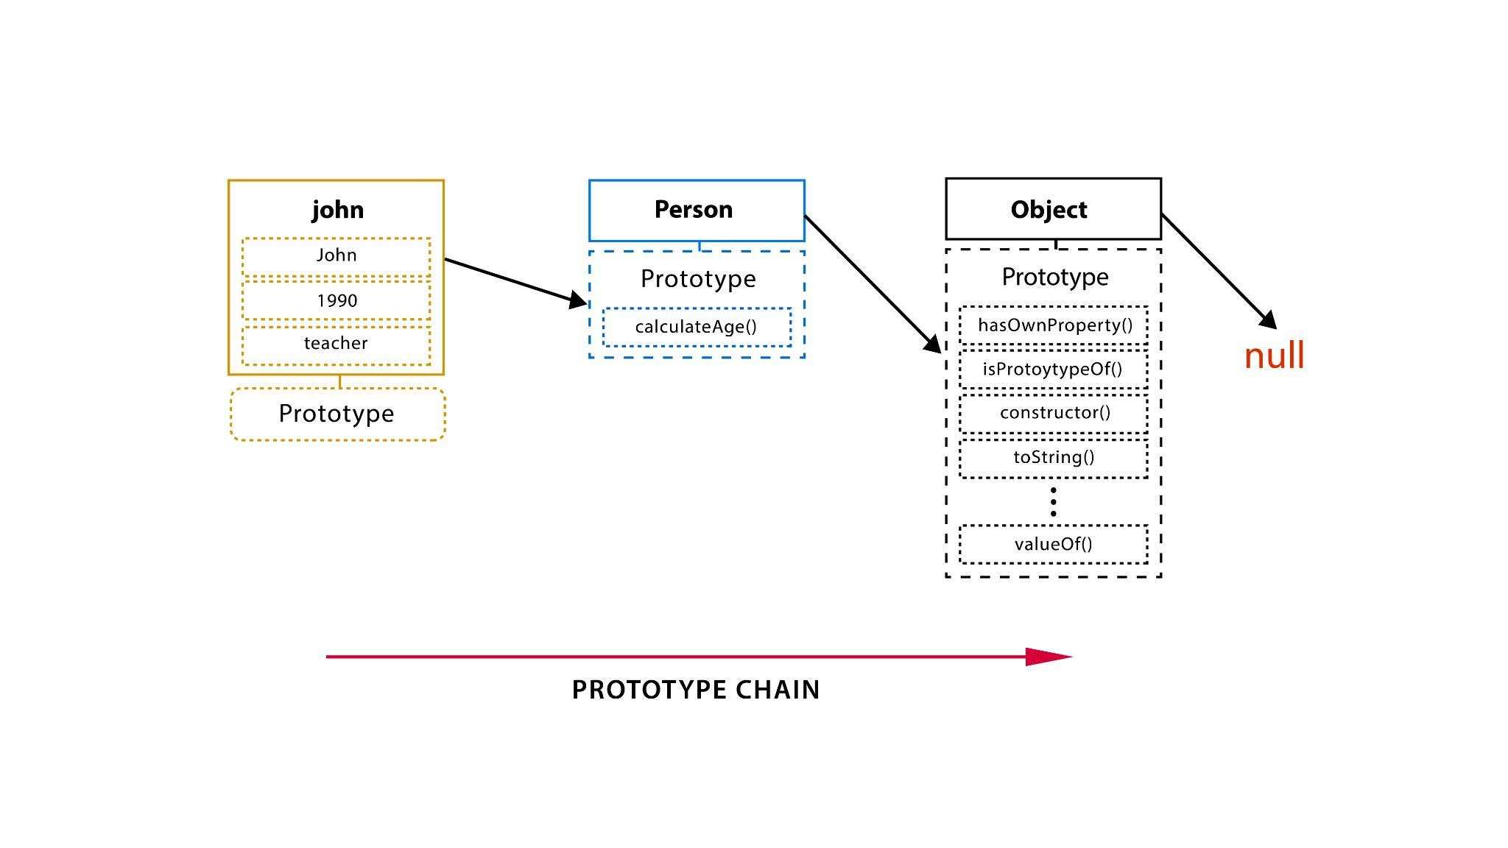

Slide 30
The Prototype Chain
Prototypal inheritance uses the concept of prototype chaining. Let’s explore that concept. Every object created contains [[Prototype]], which points either to another object or null. Envision an object C with a [[Prototype]] property that points to object B. Object B’s [[Prototype]] property points to prototype object A. This continues onward, forming a kind of chain called the prototype chain.
This concept is used when searching our code. When we need to find a property in an object, it is first searched for in the object, and if not found, it is searched for on that object’s prototype, and so on. Thus, the entire prototype chain is traversed until the property is found or null is reached.
Ref: educative.io

Slide 31
The Prototype Inheritance, Prototype Chain
Ref: Victor Dozal

Slide 32


